Slide 1


Resume Screening Using NLP
Presented By- Prathmesh Patil 248529
Rajan Jadhav 248533
Group no -14
Group Mentor- Mrs. Priti Take

Slide 2
Introduction
In resume screening using NLP we evaluating resume by extracting key information, comparing them with job descriptions and ranking resume based on relevance natural language processing.

Slide 3
Problem Statement
Recruiters receive thousands of resumes for job openings.
Manual screening is tedious and inconsistent.
Time-consuming and inefficient manual resume screening
Bias and inconsistency in hiring decisions
Difficulty in extracting relevant information from unstructured resumes
Need for an automated and efficient system to filter relevant resumes.

Slide 4
Objective
Use NLP to extract relevant information from resumes.
Rank resumes based on job descriptions.
Reduce hiring time and improve accuracy in candidate selection.
Leveraging machine learning for intelligent resume filtering
Automating candidate shortlisting

Slide 5
Dataset Details
Dataset contains structured/unstructured resumes.
Fields: Candidate Name, Skills, Experience, Education, Job Role, etc.
Source: Public resume datasets / Collected from job portals / kaggle.
Preprocessing: Text cleaning, tokenization, removing stopwords, etc.

Slide 6
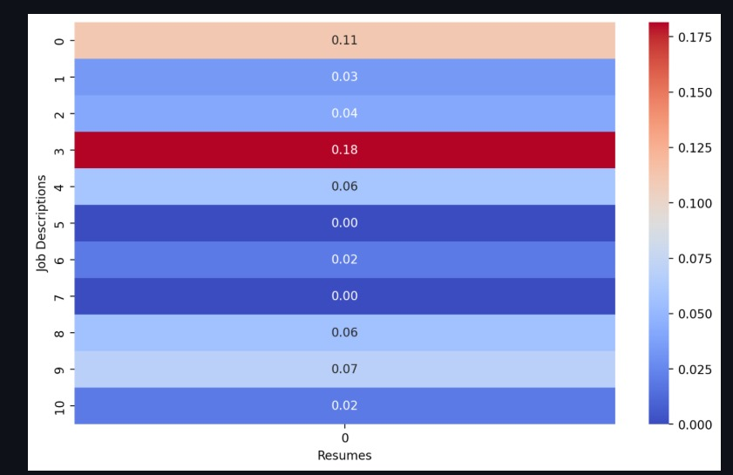
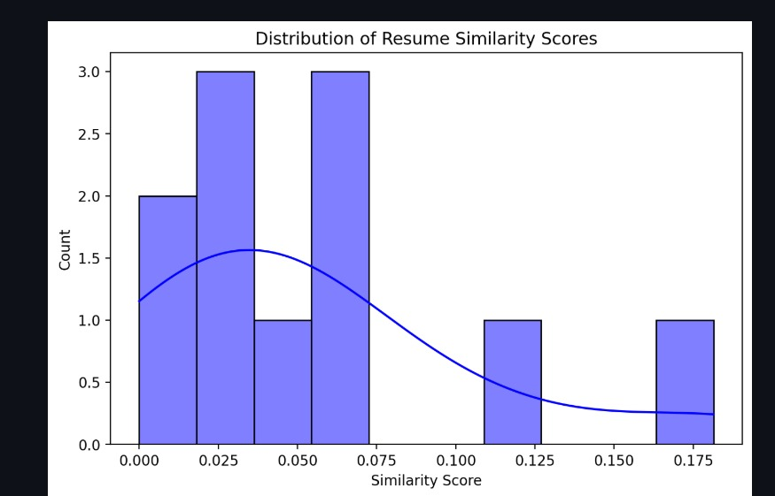
Exploratory Data Analysis (EDA)

Slide 7
Architecture/Flow Diagram
Data Collection → Preprocessing → Feature Extraction → Prediction → Shortlisted Resume.
Flowchart showing how resumes move through the system.

Slide 8
Libraries/Platform Used
Programming Language: Python
Libraries: NLTK, scikit-learn, Pandas, NumPy,Pypdf
Frameworks: Streamlit (used for UI)

Slide 9
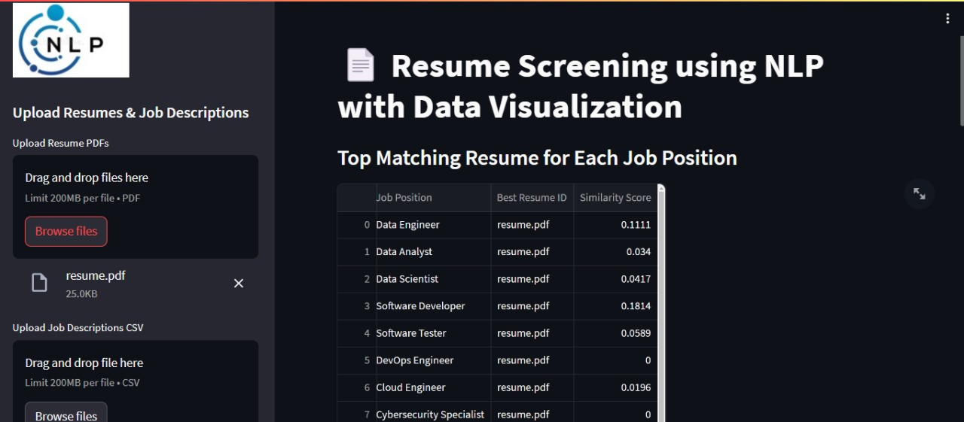
Screenshots UI

Slide 10
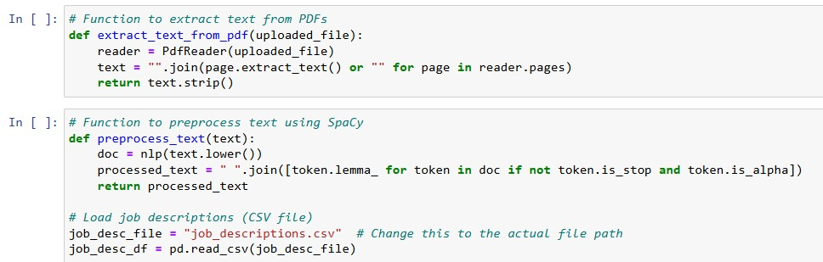
Screenshot Code

Slide 11
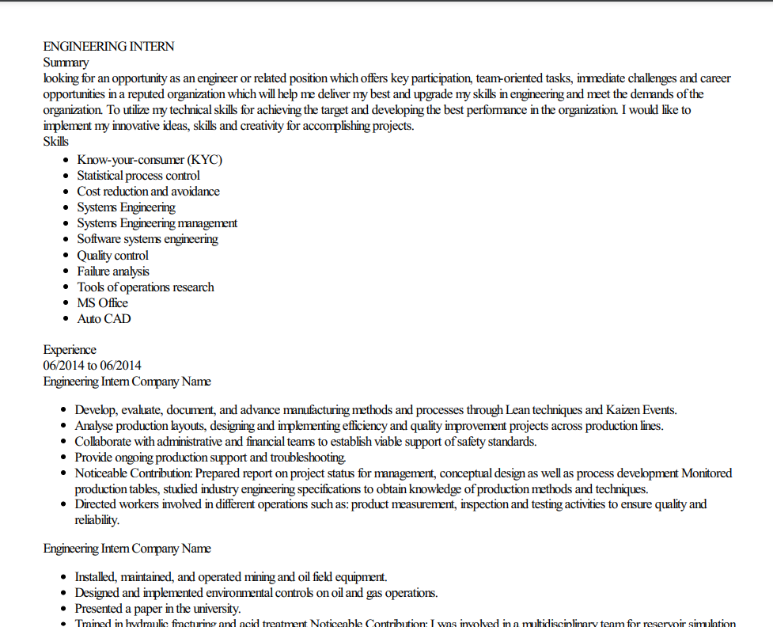
Screenshot Dataset

Slide 12
Methodology
Data Collection: Gather resumes in PDF format.
Preprocessing: Tokenization, stopword removal, stemming/lemmatization.
Feature Extraction: TF-IDF, word embeddings .
Matching with Job Description: Cosine similarity.
Ranking and Output: Score-based ranking of candidates.

Slide 13
Preprocessing
Convert resumes to text format.
Remove unnecessary characters, stopwords.

Slide 14
Resume Matching & Ranking
Cosine Similarity: Measures similarity between resume and job description.
Output: Ranked resumes with top-matching candidates.

Slide 15
Implementation Flow
Upload resumes and job description.
Process resumes using NLP techniques.
Extract relevant information.
Compare with job description using similarity measures.
Display ranked resume.

Slide 16
Result
Successfully reduced HR screening time by 50%.
Deployed an interactive web-based screening tool.

Slide 17
Conclusion
NLP-based resume screening enhances efficiency and reduces bias.
Helps recruiters focus on top candidates faster.
Future advancements can make hiring fully automated.

